Slide 1
Tips for Deep Learning

Slide 2
Slide credits
Most of these slides were adapted from:
Hung-yi Lee (National Tai Wan Univeristy)
Kris Kitani (Carnegie Mellon University).
Noah Snavely (Cornell University).
Fei-Fei Li (Stanford University).

Slide 3

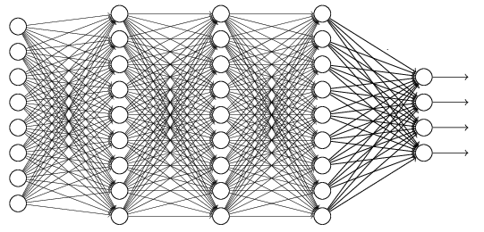
Recipe of Deep Learning
YES
Step 1: define a set of function
Step 2: goodness of function
Step 3: pick the best function
NO
Good Results on Testing Data?
Overfitting!
YES
NO
Good Results on Training Data?
Neural Network
Notes:
Other methods do not emphasize this.
Some machine learning methods do not emphasize this.

Slide 4
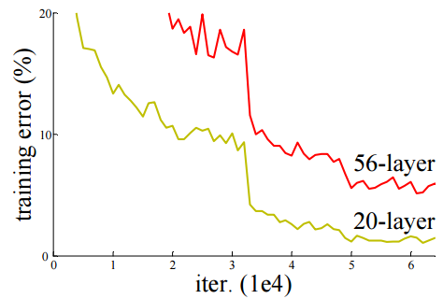
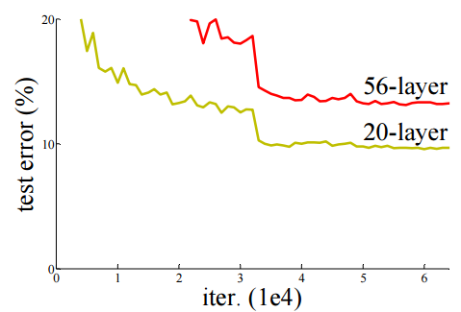

Do not always blame Overfitting
Not well trained
Overfitting?
Training Data
Testing Data
Deep Residual Learning for Image Recognition
http://arxiv.org/abs/1512.03385

Slide 5
Recipe of Deep Learning
YES
Good Results on Testing Data?
Different approaches for different problems.
YES
e.g. dropout for good results on testing data
Good Results on Training Data?
Neural Network
Notes:
加敏 加防

Slide 6
Recipe of Deep Learning
Regularization
Early Stopping
Dropout
YES
Good Results on Testing Data?
Adaptive Learning Rate
New activation function
YES
Good Results on Training Data?

Slide 7
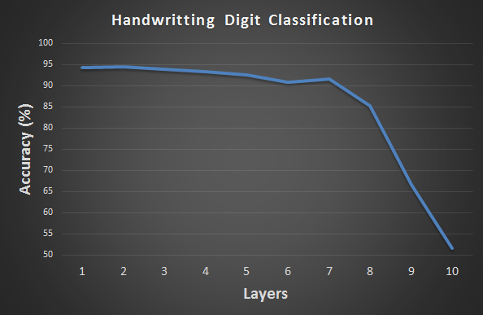
Hard to get the power of Deep …
Results on Training Data
Deeper usually does not imply better.
Notes:
感不感獎 時投湯 的故是

Slide 8
Vanishing Gradient Problem
……
y₁
……
y₂
……
……
……
……
……
……
y_{M}
Smaller gradients
Larger gradients
Learn very slow
Learn very fast
Almost random
Already converge

Slide 9
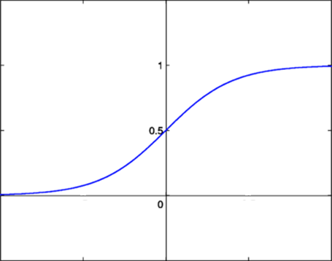




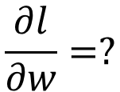






Vanishing Gradient Problem
Smaller gradients
……
$$y_{1}$$
$${\hat{y}}_{1}$$
Small output
……
$$y_{2}$$
$${\hat{y}}_{2}$$
……
……
……
……
……
$$l$$
……
$$+∆l$$
……
$$y_{M}$$
$${\hat{y}}_{M}$$
Large input
$$+∆w$$
Intuitive way to compute the derivatives …
$$\frac{∂l}{∂w}=?$$
$$\frac{∆l}{∆w}$$

Slide 10





ReLU
Rectified Linear Unit (ReLU)
Reason:
$$a$$
$$σ\left(z\right)$$
1. Fast to compute
$$a=z$$
2. Biological reason
$$a=0$$
3. Infinite sigmoid with different biases
$$z$$
4. Vanishing gradient problem
[Xavier Glorot, AISTATS’11]
[Andrew L. Maas, ICML’13]
[Kaiming He, arXiv’15]

Slide 11
ReLU
$$a$$
$$a=z$$
$$a=0$$
$$z$$
0
0
0
0

Slide 12
ReLU
$$a$$
$$a=z$$
A Thinner linear network
$$a=0$$
$$z$$
Do not have smaller gradients
Notes:
Kera Example mlp

Slide 13




ReLU - variant
$$Leaky ReLU$$
$$Parametric ReLU$$
$$a$$
$$a$$
$$a=z$$
$$a=z$$
$$z$$
$$z$$
$$a=0.01z$$
$$a=αz$$
α also learned by gradient descent
Notes:
ReLU Gradient = 0, can’t update parameters

Slide 14












Maxout
ReLU is a special cases of Maxout
Learnable activation function [Ian J. Goodfellow, ICML’13]
+
neuron
+
$$5$$
$$1$$
Input
Max
$$7$$
Max
$$2$$
+
$$7$$
+
$$2$$
+
$$−1$$
+
$$4$$
Max
$$1$$
Max
$$4$$
+
$$1$$
+
$$3$$
You can have more than 2 elements in a group.

Slide 15











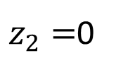







Maxout
ReLU is a special cases of Maxout
+
$$z_{1}^{}$$
$$z$$
ReLU
Input
$$w$$
$$a$$
Input
$$w$$
Max
$$b$$
$$a$$
$$0$$
+
$$z_{2}^{}$$
$$max\left\{z_{1}^{},z_{2}^{}\right\}$$
$$b$$
$$0$$
$$a$$
$$a$$
$$z=wx+b$$
$$z_{1}=wx+b$$
$$x$$
$$x$$
$z_{2}=$0

Slide 16



Maxout
More than ReLU
+
$$z_{1}^{}$$
$$z$$
ReLU
Input
$$w$$
$$a$$
Input
$$w$$
Max
$$b$$
$$a$$
+
$$z_{2}^{}$$
$$w^{′}$$
$$max\left\{z_{1}^{},z_{2}^{}\right\}$$
$$b$$
$$b^{′}$$
Learnable Activation Function
$$a$$
$$a$$
$$z=wx+b$$
$$z_{1}=wx+b$$
$$x$$
$$x$$
$$z_{2}=w^{′}x+b^{′}$$

Slide 17
Maxout
Learnable activation function [Ian J. Goodfellow, ICML’13]
Activation function in maxout network can be any piecewise linear convex function
How many pieces depending on how many elements in a group
2 elements in a group
3 elements in a group
Notes:
3,4,5

Slide 18
















Maxout - Training
Given a training data x, we know which z would be the max
+
$$z_{1}^{1}$$
+
$$z_{1}^{2}$$
Input
Max
$$a_{1}^{1}$$
Max
$$a_{1}^{2}$$
+
$$z_{2}^{1}$$
+
$$z_{2}^{2}$$
$$max\left\{z_{1}^{1},z_{2}^{1}\right\}$$
+
$$z_{3}^{1}$$
+
$$z_{3}^{2}$$
Max
$$a_{2}^{1}$$
Max
$$a_{2}^{2}$$
$$x$$
+
$$z_{4}^{1}$$
$$a^{1}$$
+
$$z_{4}^{2}$$
$$a^{2}$$

Slide 19
Maxout - Training
Given a training data x, we know which z would be the max
Train this thin and linear network
+
$$z_{1}^{1}$$
+
$$z_{1}^{2}$$
Input
$$a_{1}^{1}$$
$$a_{1}^{2}$$
+
$$z_{2}^{1}$$
+
$$z_{2}^{2}$$
+
$$z_{3}^{1}$$
+
$$z_{3}^{2}$$
$$x$$
$$a_{2}^{1}$$
$$a_{2}^{2}$$
+
$$z_{4}^{1}$$
$$a^{1}$$
+
$$z_{4}^{2}$$
$$a^{2}$$
Different thin and linear network for different examples

Slide 20
Recipe of Deep Learning
Regularization
Early Stopping
Dropout
YES
Good Results on Testing Data?
Adaptive Learning Rate
New activation function
YES
Good Results on Training Data?

Slide 21
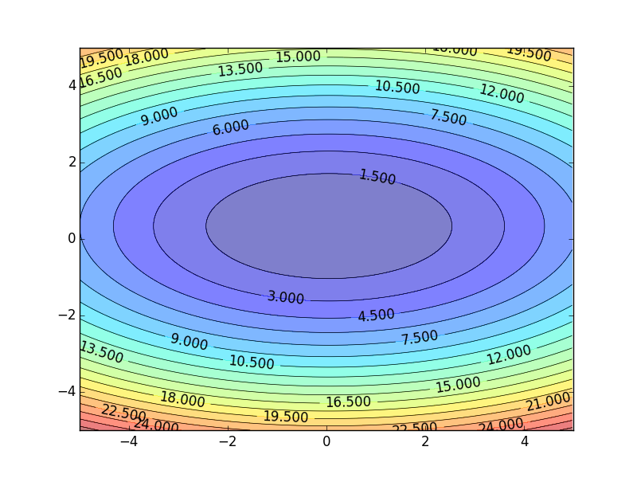
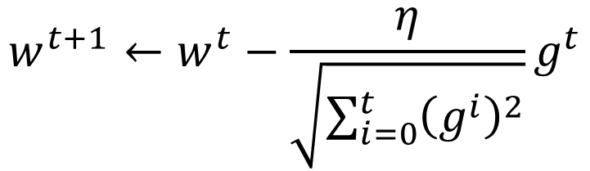


Review
Smaller Learning Rate
$$w_{2}$$
Larger Learning Rate
Adagrad
$$w_{1}$$
$$w^{t+1}←w^{t}−\frac{η}{\sqrt{\sum_{i=0}^{t}{{\left(g^{i}\right)}^{2}}}}g^{t}$$
Use first derivative to estimate second derivative
Notes:
Larger Gradient
Smaller Learning
Rate

Slide 22
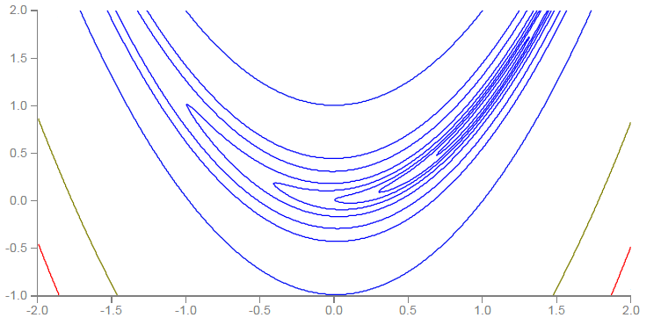


RMSProp
Error Surface can be very complex when training NN.
Smaller Learning Rate
$$w_{2}$$
Larger Learning Rate
$$w_{1}$$

Slide 23

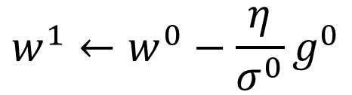

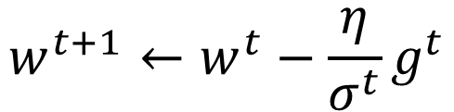

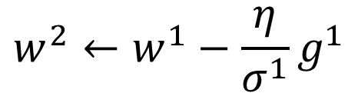


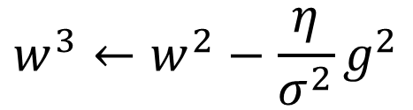
RMSProp
$$w^{1}←w^{0}−\frac{η}{σ^{0}}g^{0}$$
$$σ^{0}=g^{0}$$
$$w^{2}←w^{1}−\frac{η}{σ^{1}}g^{1}$$
$$σ^{1}=\sqrt{{α\left(σ^{0}\right)}^{2}+\left(1−α\right){\left(g^{1}\right)}^{2}}$$
$$w^{3}←w^{2}−\frac{η}{σ^{2}}g^{2}$$
$$σ^{2}=\sqrt{{α\left(σ^{1}\right)}^{2}+\left(1−α\right){\left(g^{2}\right)}^{2}}$$
$$……$$
$$w^{t+1}←w^{t}−\frac{η}{σ^{t}}g^{t}$$
$$σ^{t}=\sqrt{{α\left(σ^{t−1}\right)}^{2}+\left(1−α\right){\left(g^{t}\right)}^{2}}$$
Root Mean Square of the gradients with previous gradients being decayed
Notes:
Root Mean Squares of gradients

Slide 24



Hard to find optimal network parameters
Total
Loss
Very slow at the plateau
Stuck at saddle point
Stuck at local minima
$$∂L∕∂w$$
$$≈0$$
$$∂L∕∂w$$
$$=0$$
$$∂L∕∂w$$
$$=0$$
The value of a network parameter w
Notes:
Local minimal (all dimension) Lecun

Slide 25
In physical world ……
Momentum
How about put this phenomenon in gradient descent?
Notes:
Momentum: 動量
Gravity

Slide 26



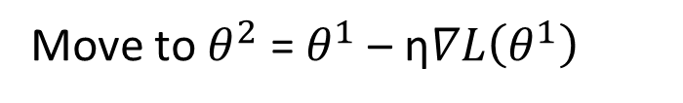

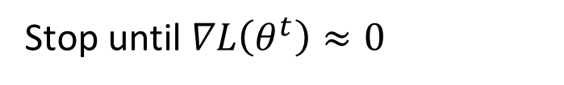
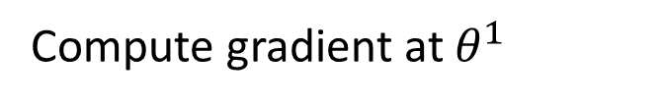

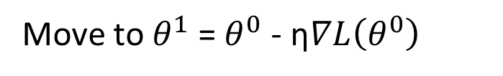


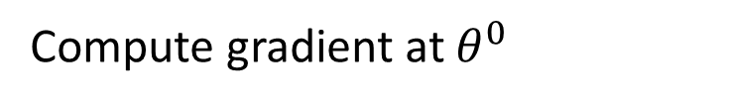


Review: Vanilla Gradient Descent
$$∇L\left(θ^{0}\right)$$
Start at position $θ^{0}$
$$∇L\left(θ^{1}\right)$$
Compute gradient at $θ^{0}$
$$θ^{0}$$
$$θ^{1}$$
Move to $θ^{1}$ = $θ^{0}$ - η$∇L\left(θ^{0}\right)$
$$∇L\left(θ^{2}\right)$$
Compute gradient at $θ^{1}$
$$θ^{2}$$
Gradient
Move to $θ^{2}$ = $θ^{1}$ – η$∇L\left(θ^{1}\right)$
Movement
$$∇L\left(θ^{3}\right)$$
$$θ^{3}$$
……
Stop until $∇L\left(θ^{t}\right)≈0$
Notes:
平凡的；普通的；乏味的

Slide 27
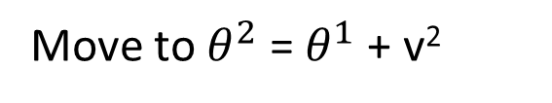

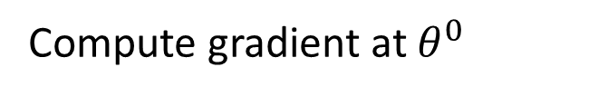
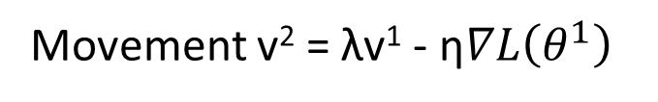

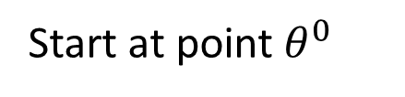

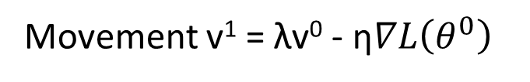

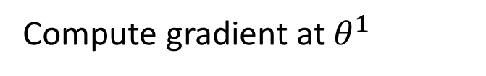


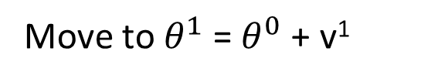


Momentum
Movement: movement of last step minus gradient at present
Start at point $θ^{0}$
Movement v⁰=0
$$∇L\left(θ^{0}\right)$$
Compute gradient at $θ^{0}$
$$∇L\left(θ^{1}\right)$$
$$θ^{0}$$
Movement v¹ = λv⁰ - η$∇L\left(θ^{0}\right)$
$$θ^{1}$$
Move to $θ^{1}$ = $θ^{0}$ + v¹
$$∇L\left(θ^{2}\right)$$
Compute gradient at $θ^{1}$
$$θ^{2}$$
Gradient
Movement v² = λv¹ - η$∇L\left(θ^{1}\right)$
Movement
Move to $θ^{2}$ = $θ^{1}$ + v²
$$θ^{3}$$
$$∇L\left(θ^{3}\right)$$
Movement not just based on gradient, but previous movement.
Movement
of last step

Slide 28
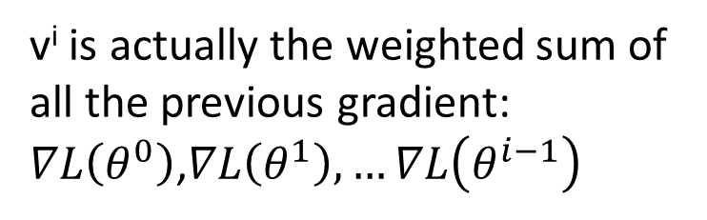
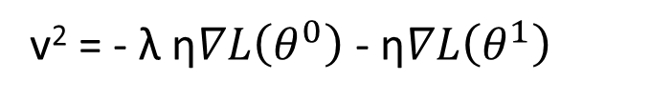
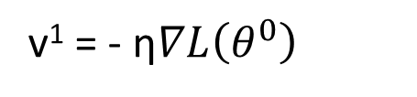
Momentum
Movement: movement of last step minus gradient at present
Start at point $θ^{0}$
Movement v⁰=0
Compute gradient at $θ^{0}$
v^{i} is actually the weighted sum of all the previous gradient: $∇L\left(θ^{0}\right)$,$∇L\left(θ^{1}\right), …∇L\left(θ^{i−1}\right)$
Movement v¹ = λv⁰ - η$∇L\left(θ^{0}\right)$
Move to $θ^{1}$ = $θ^{0}$ + v¹
v⁰ = 0
Compute gradient at $θ^{1}$
v¹ = - η$∇L\left(θ^{0}\right)$
Movement v² = λv¹ - η$∇L\left(θ^{1}\right)$
Move to $θ^{2}$ = $θ^{1}$ + v²
v² = - λ η$∇L\left(θ^{0}\right)$ - η$∇L\left(θ^{1}\right)$
Movement not just based on gradient, but previous movement
……
Notes:
Lambda = 0.9

Slide 29
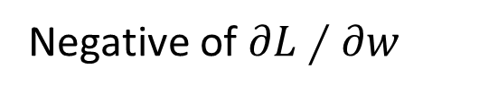
Momentum
Still not guarantee reaching global minima, but give some hope ……
cost
Movement =
Negative of 𝜕𝐿∕𝜕𝑤 + Momentum
Negative of $∂L∕∂w$
Momentum
Real Movement
𝜕𝐿∕𝜕𝑤 = 0
Notes:
What can we see?

Slide 30
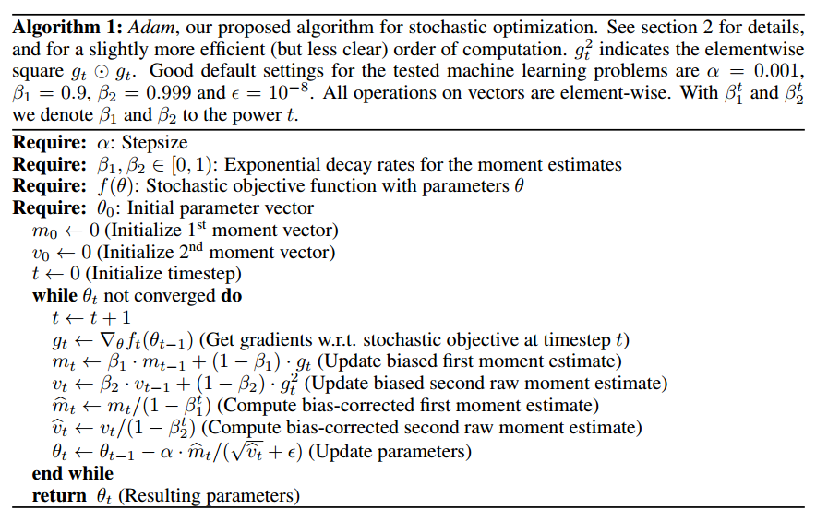
Adam
RMSProp + Momentum
for momentum
for RMSprop
Notes:
http://sebastianruder.com/optimizing-gradient-descent/
http://cs231n.github.io/neural-networks-3/
Original paper: https://arxiv.org/pdf/1412.6980.pdf

Slide 31
Recipe of Deep Learning
Regularization
Early Stopping
Dropout
YES
Good Results on Testing Data?
Adaptive Learning Rate
New activation function
YES
Good Results on Training Data?

Slide 32
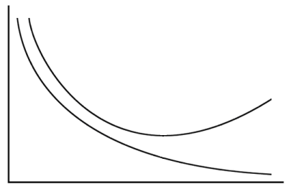
Early Stopping
Total
Loss
Stop at here
Validation set
Testing set
Training set
Epochs
Keras:
http://keras.io/getting-started/faq/#how-can-i-interrupt-training-when-the-validation-loss-isnt-decreasing-anymore
Notes:
Validation set: The data set can used to evaluate your model but not involve in training.
Validation set: seplit from training data
Acturally is difficult
http://deeplearning.net/tutorial/mlp.html#mlp

Slide 33
Recipe of Deep Learning
Regularization
Early Stopping
Dropout
YES
Good Results on Testing Data?
Adaptive Learning Rate
New activation function
YES
Good Results on Training Data?

Slide 34
Regularization
New loss function to be minimized
Find a set of weight not only minimizing original cost but also close to zero
Regularization term
Original loss
(e.g. minimize square error, cross entropy …)
L2 regularization:
(usually not consider biases)
Notes:
L1 is also good, subtle difference

Slide 35
Regularization
L2 regularization:
New loss function to be minimized
Gradient:
Update:
Weight Decay
Closer to zero
Notes:
If p=2, then the regularizer is also called “weight decay”.

Slide 36
Regularization
L1 regularization:
New loss function to be minimized
Update:
Always delete
…… L2
Notes:
If p=2, then the regularizer is also called “weight decay”.

Slide 37
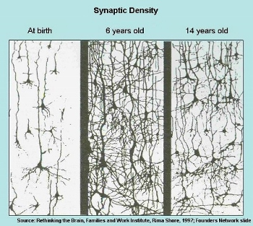
Regularization - Weight Decay
Our brain prunes out the useless link between neurons.
Doing the same thing to machine’s brain improves the performance.
Notes:
人腦會遺忘久沒用的資訊
One kind of regularization

Slide 38
Recipe of Deep Learning
Regularization
Early Stopping
Dropout
YES
Good Results on Testing Data?
Adaptive Learning Rate
New activation function
YES
Good Results on Training Data?

Slide 39
Dropout
Training:
Each time before updating the parameters
Each neuron has p% to dropout
Notes:
Iteration v.s. epoch!!!!!!!!

Slide 40
Dropout
Training:
Thinner!
Each time before updating the parameters
Each neuron has p% to dropout
The structure of the network is changed.
Using the new network for training
For each mini-batch, we resample the dropout neurons
Notes:
Do not worry that someone will not update

Slide 41
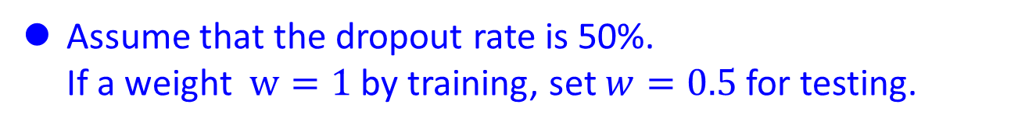
Dropout
Testing:
No dropout
If the dropout rate at training is p%, all the weights times 1-p%
Assume that the dropout rate is 50%.
If a weight $w=1$ by training, set $w=0.5$ for testing.
Notes:
Bias do not have to multiply !!!!!!!!!!!!!!!!!!!!!!!!!!!!!!!!!!!
Reasonable !!!!!!!!!!!!!!!!!!!!

Slide 42
Dropout - Intuitive Reason
My teammate will not work hard on project. I need to work hard.
When teams up, if everyone expect the partner will do the work, nothing will be done finally.
However, if you know your partner will dropout, you will do better.
When testing, no one dropout actually, so obtaining good results eventually.
Notes:
Why the weights should multiply p (dropout rate) at testing?

Slide 43
















Dropout - Intuitive Reason
Why the weights should multiply (1-p)% (dropout rate) when testing?
Training of Dropout
Testing of Dropout
Assume dropout rate is 50%
No dropout
Weights from training
$$w_{1}$$
$$0.5×$$
$$w_{1}$$
$$z^{′}≈2z$$
$$w_{2}$$
$$z$$
$$0.5×$$
$$w_{2}$$
$$z^{′}$$
$$w_{3}$$
$$0.5×$$
$$w_{3}$$
$$w_{4}$$
$$0.5×$$
$$w_{4}$$
Weights multiply 1-p%
$$z^{′}≈z$$
Notes:
important

Slide 44
Dropout is a kind of ensemble.
Training Set
Ensemble
Set 1
Set 2
Set 3
Set 4
Network
1
Network
2
Network
3
Network
4
Train a bunch of networks with different structures

Slide 45
Dropout is a kind of ensemble.
Ensemble
Testing data x
Network
1
Network
2
Network
3
Network
4
y₁
y₂
y₃
y₄
average

Slide 46
Dropout is a kind of ensemble.
minibatch
1
minibatch
2
minibatch
3
minibatch
4
Training of Dropout
M neurons
……
2^{M} possible networks
Using one mini-batch to train one network
Some parameters in the network are shared

Slide 47
Dropout is a kind of ensemble.
Testing of Dropout
testing data x
All the weights multiply 1-p%
……
y₁
y₂
y₃
?????
average
≈
y
Notes:
0,0 -> 0
1,0 -> 1
0,-1 -> -2
1,-1 -> -1
½, -1/2 -> -0.5
1,2
Geometric Mean?

Slide 48


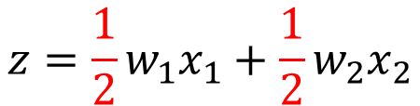
Testing of Dropout
x₁
x₂
x₁
x₂
x₁
x₂
w₁
w₂
w₁
w₂
w₁
w₂
z=w₁x₁+w₂x₂
z=w₁x₁+w₂x₂
z=w₂x₂
x₁
x₂
x₁
x₂
x₁
x₂
$$\frac{1}{2}$$
$$\frac{1}{2}$$
w₁
w₁
w₁
w₂
w₂
w₂
$$z=\frac{1}{2}w_{1}x_{1}+\frac{1}{2}w_{2}x_{2}$$
z=w₁x₁
z=0

Slide 49
Recipe of Deep Learning
YES
Step 1: define a set of function
Step 2: goodness of function
Step 3: pick the best function
NO
Good Results on Testing Data?
Overfitting!
YES
NO
Good Results on Training Data?
Neural Network
Notes:
Other methods do not emphasize this.

Slide 50


Dropout - Intuitive Reason
Testing
No dropout
Training
Dropout

